Slide 1
Functional Programming
Haskell

Slide 2
Landmarks in Functional Programming
λ-Calculus -- Alonzo Church, 1936-1941
LISP -- John McCarthy, 1958
S-Expressions (article)
ML -- Robin Milner, 1973
Miranda -- David Turner, 1985
Haskell -- Simon Peyton Jones and many others, 1990

Slide 3
Other Popular Functional Languages
Scala -- Java related OOP/FP hybrid
F# -- Microsoft’s .NET OOP/FP hybrid
Erlang -- Ericsson’s fault tolerant, parallel, pure FP
Clojure -- Java based Lisp dialect
Scheme/Common Lisp -- Modern Lisp
OCaml -- Multi-paradigm

Slide 4
Functional
Simple model of programming: “one value, the result, is computed on the basis of others, the inputs.”
Everything is a function: inputs → output
Pure Functions
Same input, same output
No side effects
Referentially transparent
Functions with superpowers

Slide 5
For Pure Functional: NO
statements
assignment statements
variables as we’re used to
side-effects
flow of control (for, while, do loops ...)
complex scope rules
direct connection with the CPU and architecture
objects
const
static
+=
++

Slide 6
Why?
Power and elegance
Better modularity and abstraction
Shorter and easier to understand
Eliminates sources of errors
“Easier” to prove correctness
Order of execution is irrelevant
Better for concurrent execution: parallel cpu’s
Generally very type-safe

Slide 7
Factorial
Functional
Imperative

Slide 8

Convert list of Integers to list of Strings, then collapse to a single String
Haskell
Java

Slide 9
Haskell
Java
Suffers from “indexitis”

Slide 10
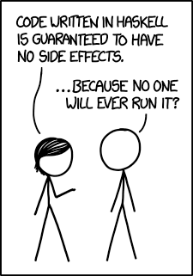
It’s OK to laugh.
Why is it that this isn’t THE way to write code?
Why is it that this isn’t THE way to solve problems?

